Slide 1
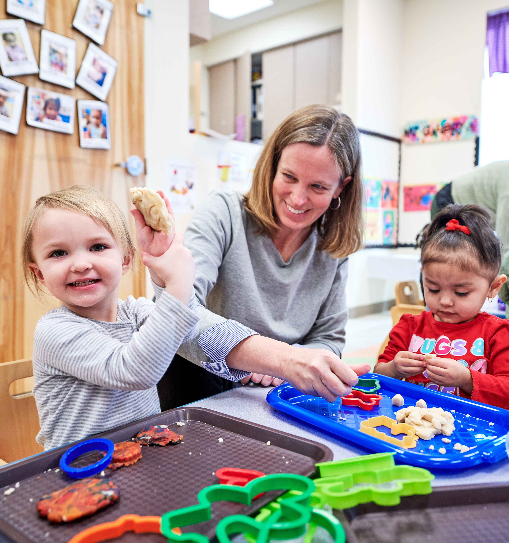

SGD Communication Intervention for Autistic Preschoolers: Predictors of Response and Effectiveness on Peer-Directed Communication
Kathy Bourque, PhD, CCC-SLP
thiemann@ku.edu
Kandace Fleming, PhD, Stacy Johner, Sevdenur Tatli
Juniper Gardens Children’s Project, University of Kansas
NIH, NIDCD, R21: DC09215

Slide 2
Agenda
Disclosure and Introduction | 3 min
Background and Rationale Peer-Mediated Interventions | 5 min
SGD Intervention with Peers | 10 min
Data Sharing and Discussion | 7 min
Conclusion and Questions | 5 min
Notes:
The primary objective of this presentation is to share outcomes and provide feasible, school-based intervention strategies to enhance communication and social interactions of autistic preschoolers with complex communication needs.

Slide 3
Co-Investigators:
Dr. Brian Boyd, UNC
Dr. Brenda Salley, KUMed
Staff:
Stacy Johner, Assistant Researcher
Sev Tatli, Student Researcher
Janet Weaver, Project Coordinator
Consultants:
Dr. Fred Shic, University of Washington
Dr. James McPartland, Yale University School of Medicine

Slide 4
Financial Relationships
I have a financial relationship relevant to the content of the proposal. I am a salaried, full-time employee with the University of Kansas
Nonfinancial Relationships
I do not have nonfinancial relationships relevant to the content of the proposal.

Slide 5
Research Questions:
For N=24 autistic preschool children with limited or no spoken language, determine if:
(1) Peer-directed communication and multi-turn exchanges change across preschool settings in response to an SGD communication intervention.
(2) Changes in child communication outcomes are related to baseline levels of child predictors (i.e., receptive and expressive language, nonverbal skills).

Slide 6
Rationale: SGD Intervention & Responsive Peers
Stay-Play-Talk with iPad
Peers as Responsive Communication Partners
Improved Child Outcomes
- Communication with peers
- Reciprocity (communicative turns)
- Range of communicative functions
- Positive social validity ratings by teachers and other school staff
- Evidence-based intervention, 1970’s
- Successful interactions and opportunities across settings
- Provide verbal and augmented input
(Bourque 2020; Bourque & Goldstein, 2020 Thiemann-Bourque et al., 2016; 2017; 2018)
Notes:
Teaching peers to be responsive communication partners is an evidence-based intervention with studies originating back to the 1970s. Peers can be a strong resource in classroom social settings, and have been successfully taught a wide range of social interaction and communication skills in preschool, elementary, and high school settings.
For today’s talk, I will focus on one adaptation to Stay-Play-Talk strategies, initially examined and published by my mentor Howard Goldstein and colleagues in the 1990’s. This adaptation focuses on including augmentative and alternative communication (AAC) options, in this study an ipad with voice output app, teaching all children the same system. We have published a number of studies showing that when SGD is combined with peer-mediated interventions, outcomes lead to greater spontaneous communication with peers, communication reciprocity, and a greater range of communicative functions. Ratings by school staff have been positive for both autistic children and their peer partners in relation to social competencies.
Within the Stay-Play-Talk with iPad PMI, peers are taught to provide verbal models and augmented input to initiate and respond, within structured play activities. We are now beginning to look more closely at individual child predictors of response to this SGD intervention.

Slide 7


Possible Predictors of Response
Proximal child variables that may predict response to PMI
Receptive Language
Expressive Language
Nonverbal Cognitive Skills
Preschool Language Scale: AC
Preschool Language Scale: EC
Visual Reception and Fine Motor on Mullen Scales of Early Learning
Mullen Scales of Early Learning: RL
Mullen Scales of Early Learning: EL
Notes:
Studies on tx response to early interventions report contradictory findings, likely due to a lack of analysis of individual child behaviors. We have observed that children begin to communicate more often and engage in reciprocal interactions at different rates; this is not surprising; yet we don’t know why or how to adapt instruction to address this variability, doing so would help us understand how to individualize social interventions to benefit children with complex communication needs.
We measured receptive language (PLS:5 AC and MSEL: RL), expressive language (PLS and Mullen EL), and nonverbal cognitive skills to determine relationships with post-treatment child communication outcomes

Slide 8
Main Components of SGD Intervention:
Stay-Play-Talk with iPad
1
2
Prompt through Peer
Set up the environment
3
4
iPad with TouchChat app
Communication Exchanges
- Child preferences (ask parents)
- Engaging and motivating toys
- Find the balance – regulation is key
Least to most hierarchy
Once every 30 seconds
Peer models talking out loud and iPad
- Different reasons to communicate: requests, comments, social interaction (high five), gain attention, protest
- Photos of peers programmed
- 3-4 communication turns, then play
- Help child and peer be successful
- Observe – spontaneous is key

Slide 9
Participants
Diagnosis of autism (N=24; 3;1 to 5;5 years)
Limited or no spoken communication (< 20 spontaneous words)
Attending preschool program with access to neurotypical peers
English as primary language
Symbol discrimination skills – using or candidate for speech-generating device (SGD) to augment communication (iPad as SGD)
Peers: N=47; 3;8 to 5;6 years; 1 to 3 per child (take turns in 1:1 play)
Recommended by school team
Share characteristics of being responsive and willing to participate
Notes:
we completed the ados 2 module 1 to confirm diagnosis of autism

Slide 10
Methods
Four independent cohorts over 2 years; two cohorts per school year
Single group pre-post treatment design across four cohorts (N=24)
Baseline data collection: dyad, snack and free play
Peer Training: two 30-min sessions on Stay-Play-Talk with iPad
SGD Intervention: 16 sessions, 2x/week for 30 min, 1:1 (child:peer)
  Implemented by trained research staff
  5 min: Review and practice three buddy steps
  5 min: Practice with Child and peer
  10-15 min: Play, with prompts for child and peer communication
  5 min: Feedback and reinforcement

Slide 11
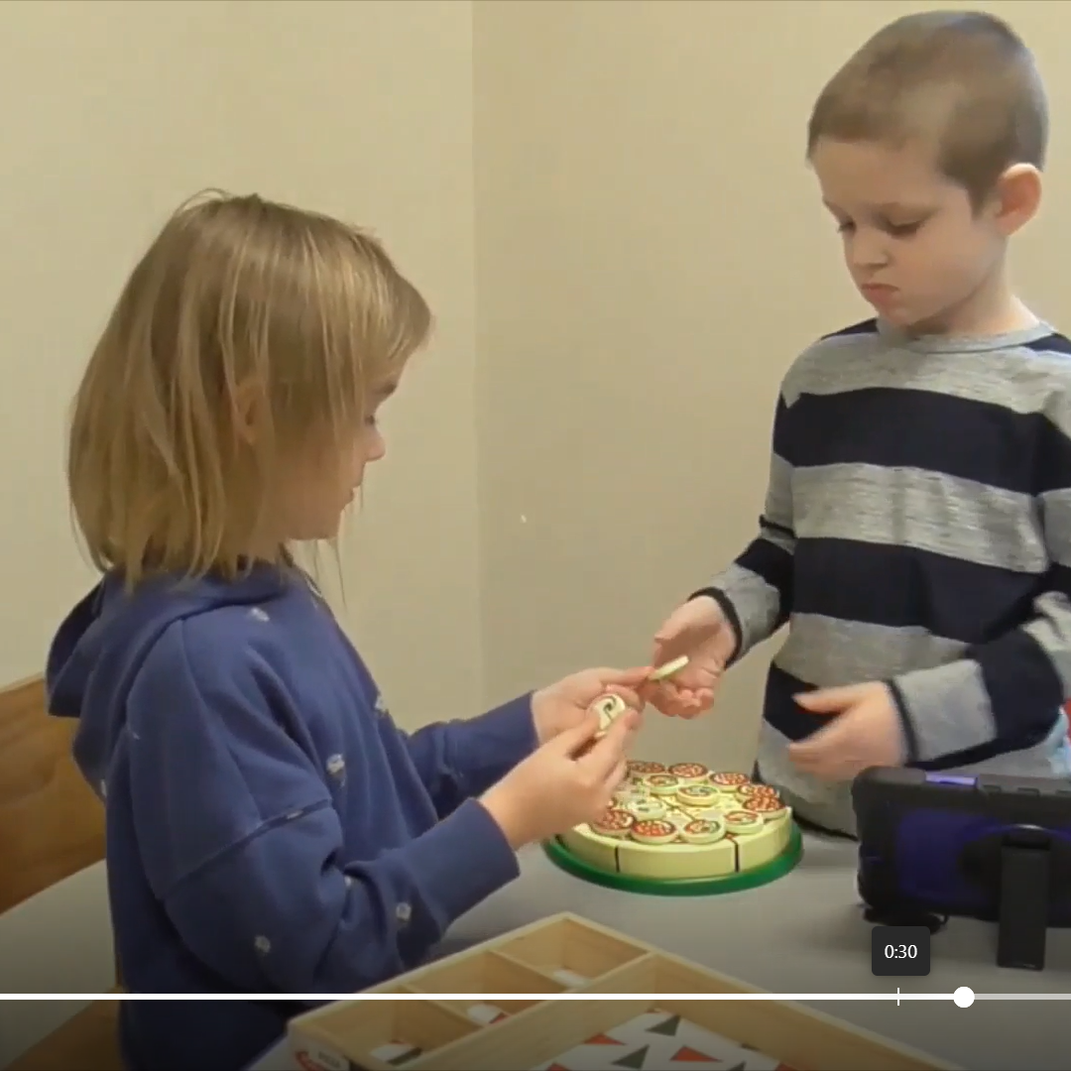
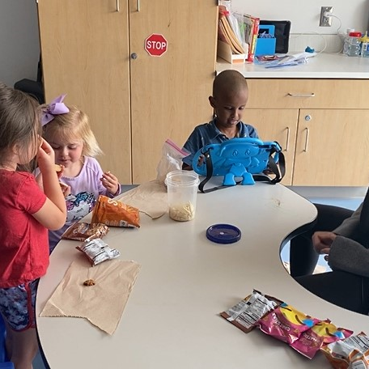
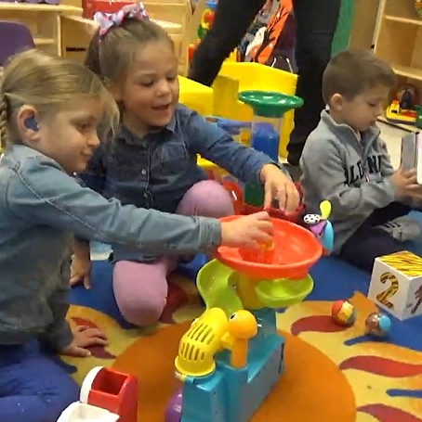
Pre- and Post-Treatment Observations
DYAD TABLE 1:1
30 min
In quiet room
SNACK 1:2
10 min
In classroom
FREE PLAY 1:2
10 min
In Classroom
Notes:
Data was collected in dyadic play, same as the intervention with no instruction or prompts; and generalization of skills to snack and free play

Slide 12
Baseline Dyadic Play: Trains
Notes:
20 seconds

Slide 13
Peer Training: Buddy Book

Slide 14
Other Ways to be a Buddy

Slide 15
5 min: Peer Review and Practice

Slide 16
SGD Treatment 1: 5 min Peer Review
Notes:
TALL Tx 1 Peer Review
0:00 to 1:00​​:
Start of peer review SPT steps; sentence completion; prompt correct response with specific words from buddy steps
3:54-4:43: Adult models things to say with iPad
5:25-6:05: Hold and wait practice

Slide 17
Child and Peer Practice: 5 min
Notes:
Create opportunities to communicate, peer holds and waits
Child prompted to communicate 2x, prompt peer to respond (reciprocal interaction)
Peer provided opportunity to use iPad, augmented input and verbal models
FC prompted to respond
TALL –TALL Tx 0:0:10 to 1:55​
Implementer prompts peer to H and W​
Child looks at implementer; don’t respond​
Move toy away to create communication opportunities​
FC found hammer on different page; KB waited 20 sec before prompting​
Okay to reinforce during 5 min instruction time, then try not to interrupt by verbal praise, on the down low​
Adult only gives 2 pieces to peer ​
TALL Tx 2:30-3:00​
Peer’s turn to request/talk out loud – first time too quiet, FC not attending to peer​
Prompt to say again so successful exchange; move toy away from FC​
TALL Tx 3:30-4:00​
3:30-4:00 Prompted peer to “say what you see” and used visual cue card (only skill she wasn’t using which is common)​

Slide 18
10-15 min: Play Time, Child and Peer
5 min: Feedback and Reinforcement

Slide 19
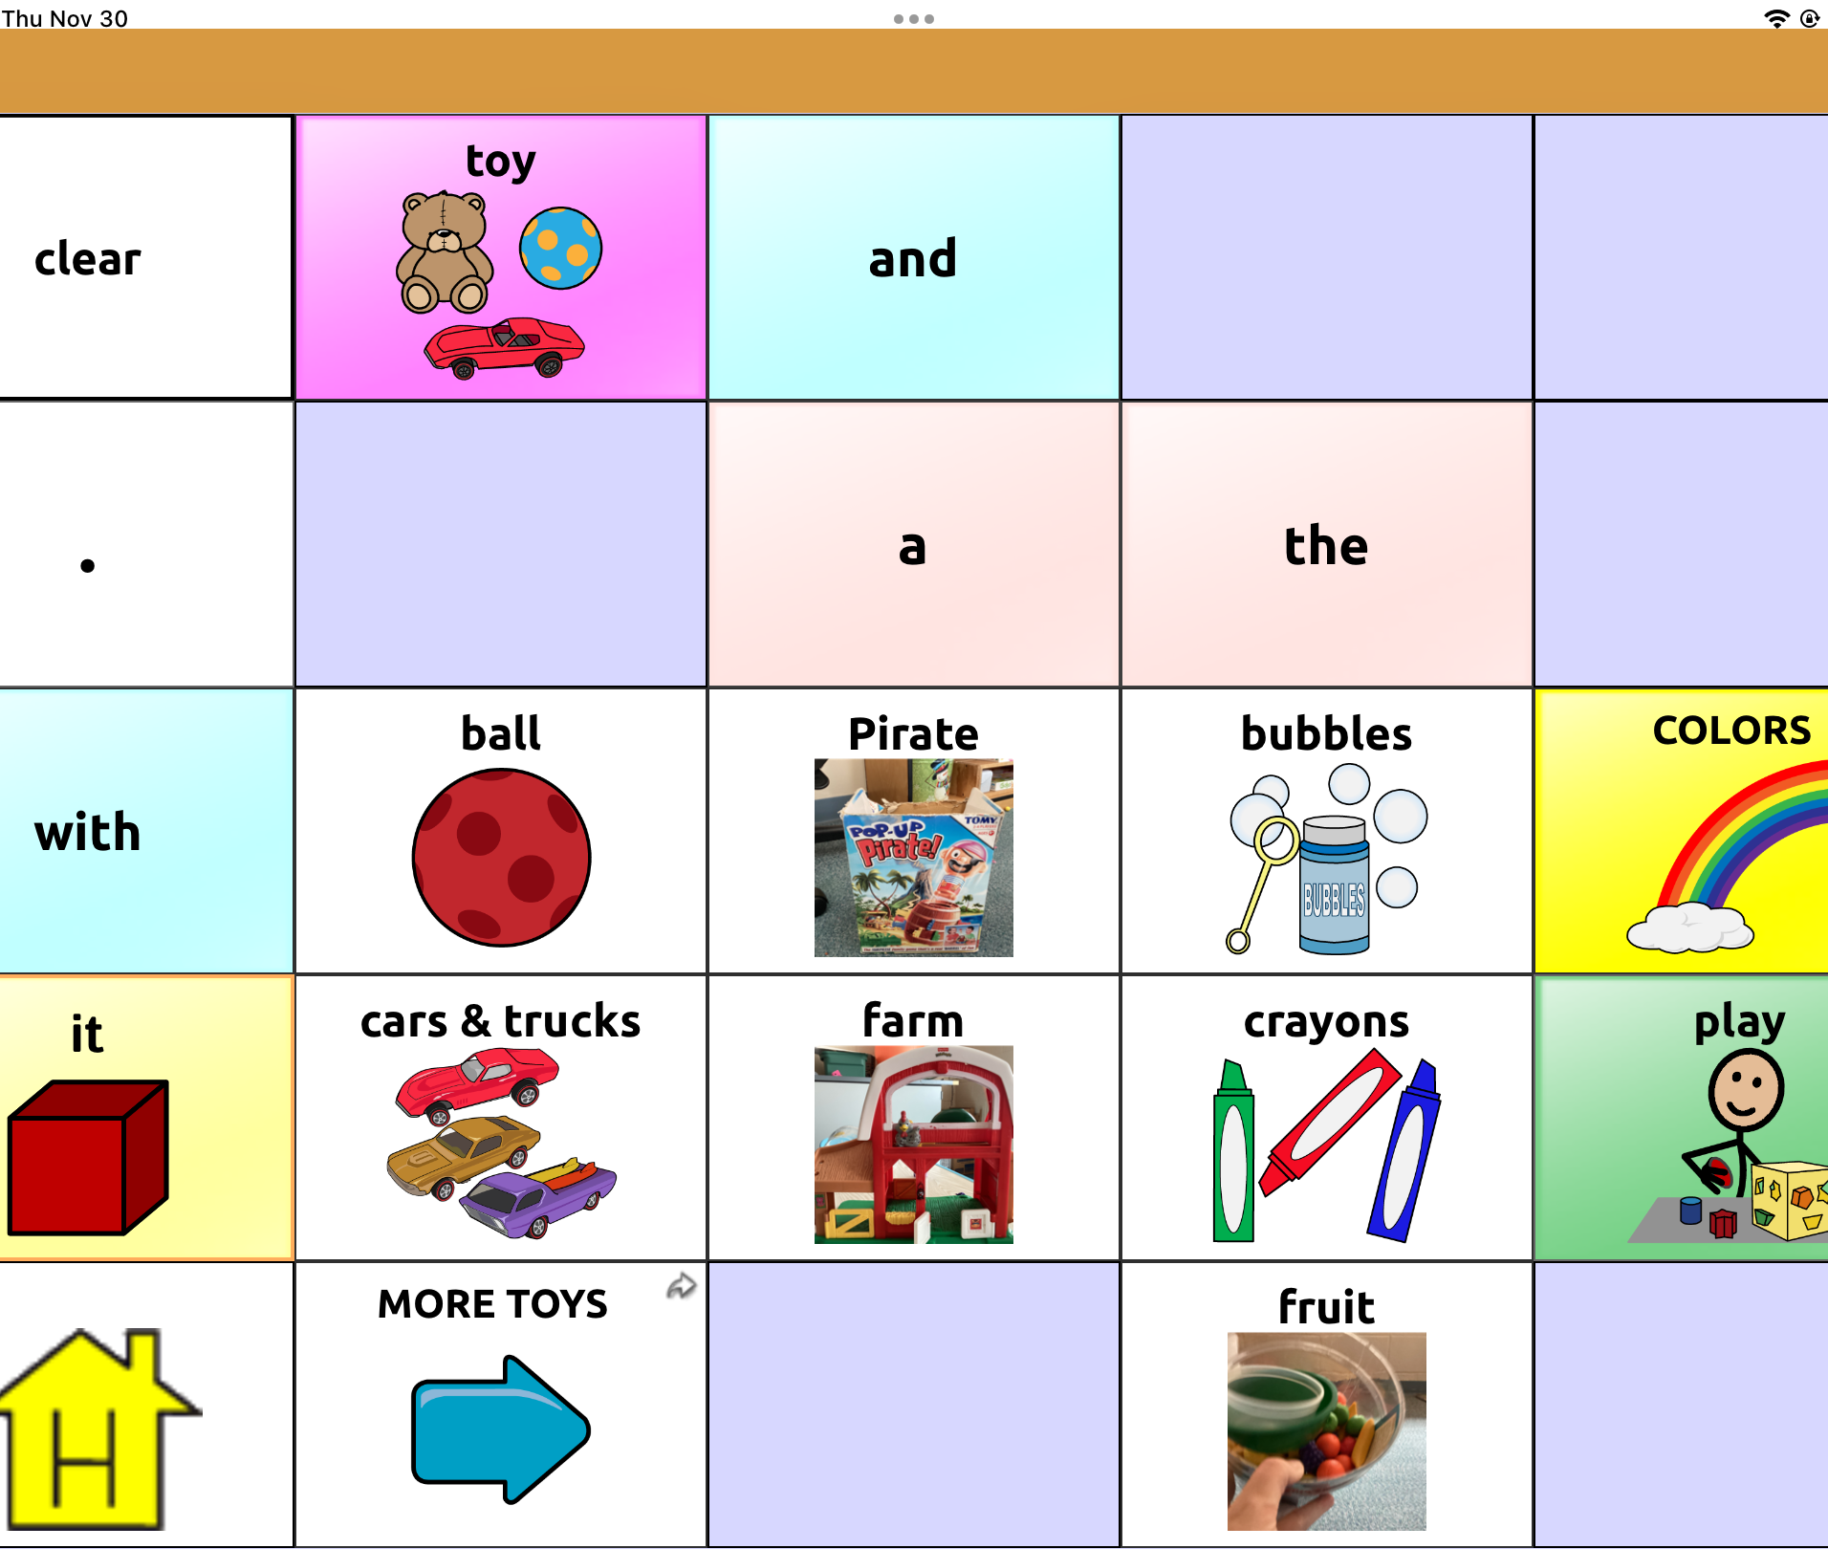
Bubbles Page
Functional Communication
- Limited to requesting objects
TouchChat : Word Power 25

Slide 20
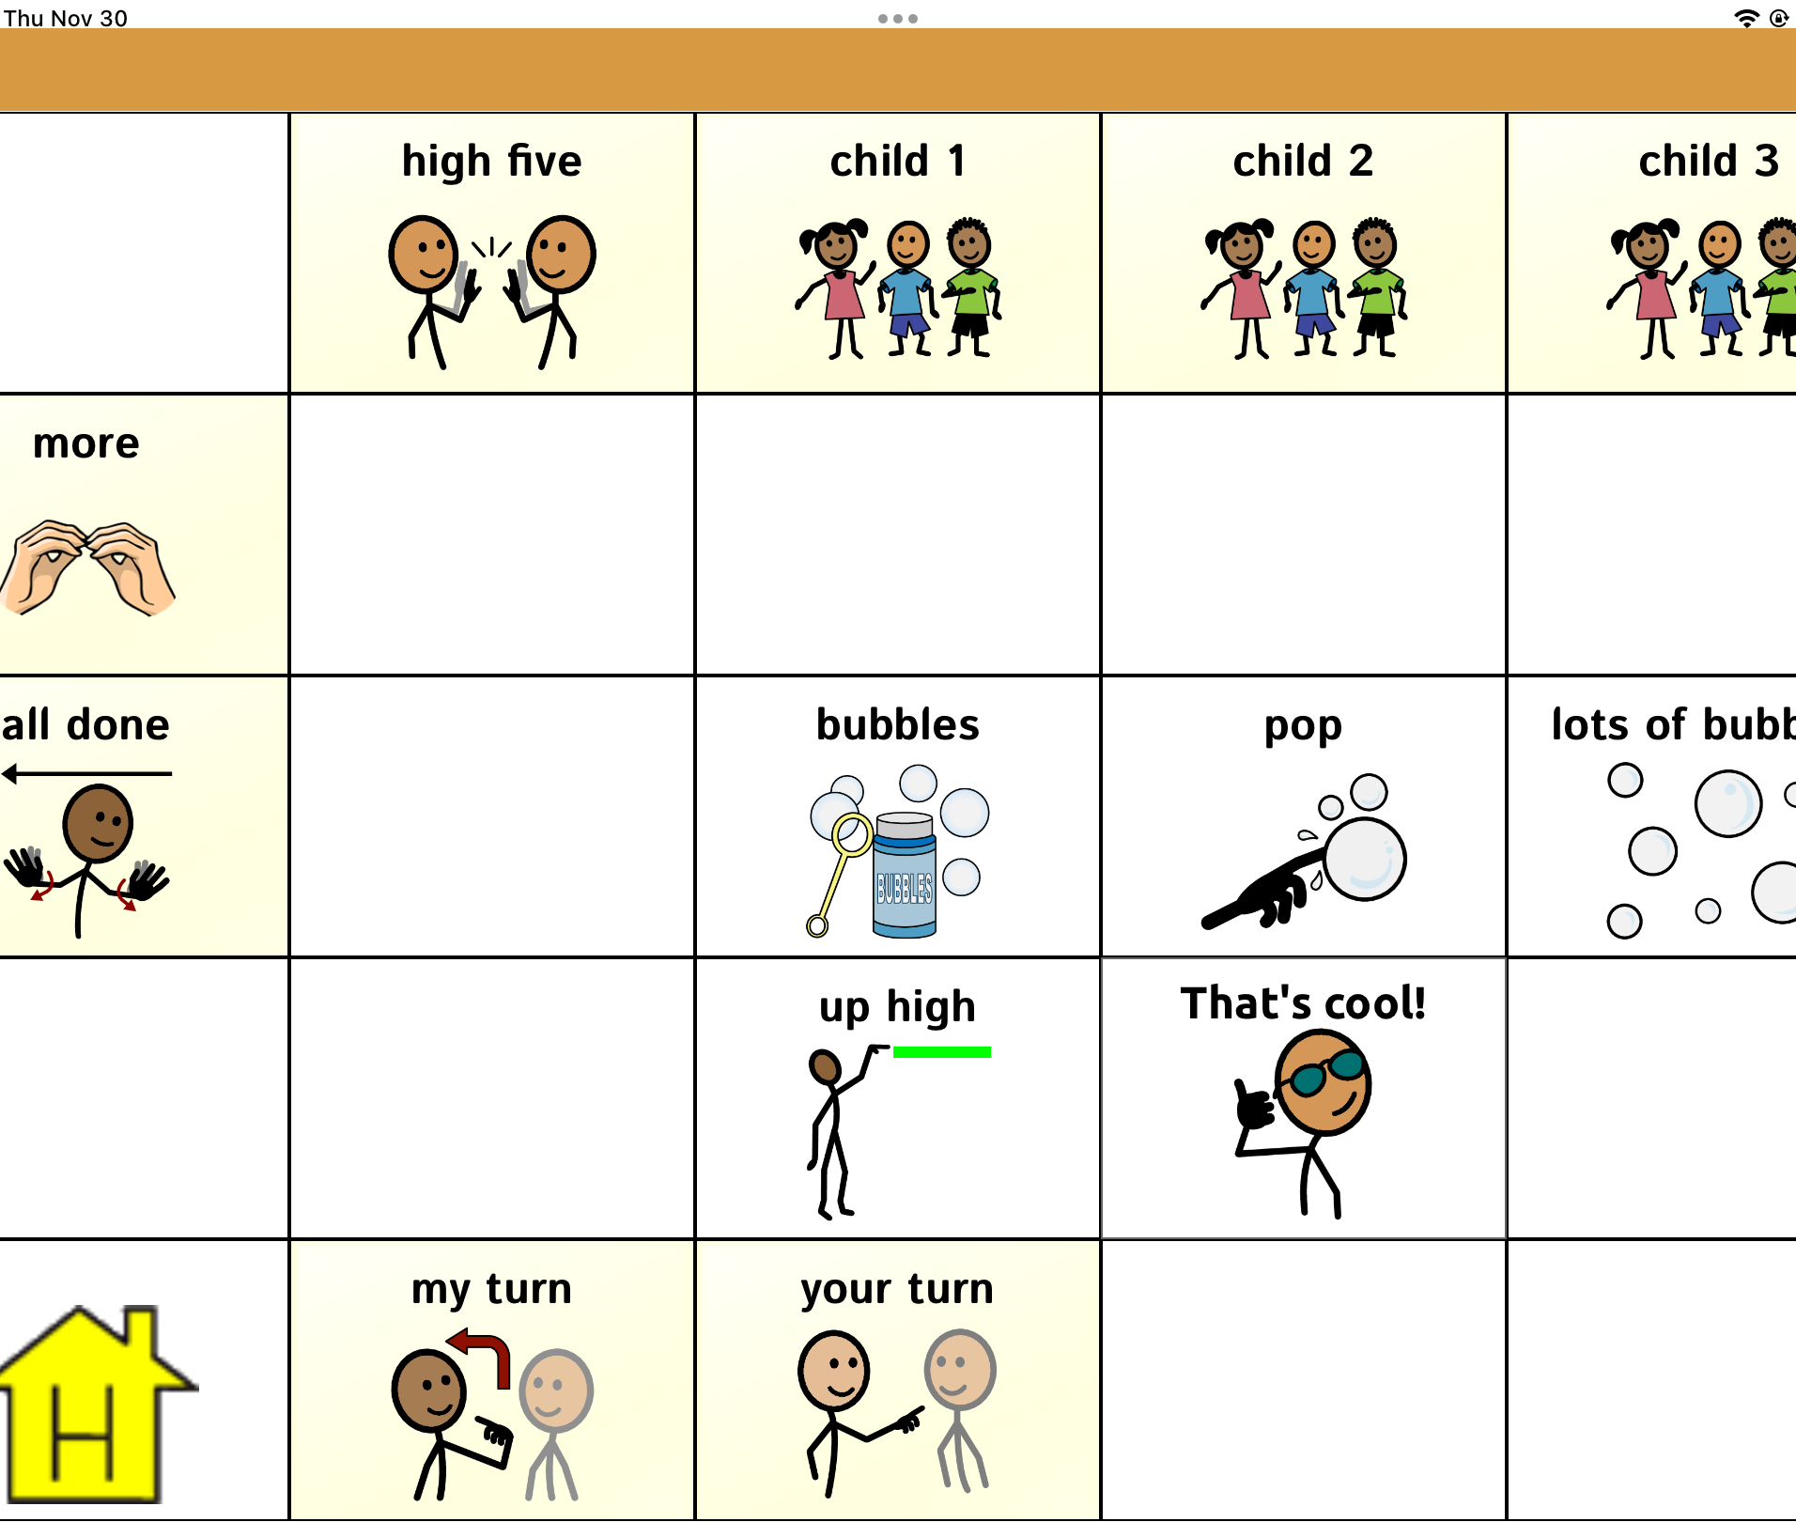
Bubbles Page
Functional Communication:
Comments
Requests for objects
Requests for actions
Social interaction
Gain attention

Slide 21
Child Communication Outcomes
Collected at baseline and post-treatment (16 sns, approx. 8 weeks):
Total RPM of spontaneous intentional communication directed to peer – Five types of acts: speech, SGD, speech+SGD, gestures, & vocalizations
Total RPM of expressive language ONLY – speech, SGD, & speech+SGD
Total RPM of multi-turn episodes (initiations and responses within 3 sec)
*For each outcome total frequency of spontaneous acts was converted to a rate per minute (RPM) and used in analyses; peer behaviors are also coded for episodes.
Notes:
Important to measure all modalities of communication – speech, SGD, speech+SGD, gestures and vocalizations (believe are potentially communicative if directed to the shared activity or to the peer)
Also interested in expressive language gains, and rate of reciprocal interactions or how children maintain exchanges with each other

Slide 22
Post-Treatment Dyad Play (16 sns): Pizza

Slide 23
Changes in Peer-directed Communication
QU1
Notes:
For the first research question, from baseline to post-treatment, rates of peer-directed communication increased significantly within all three social contexts: dyadic play (t(23) =-5.40, p<.001, d=1.10), free play (t(23)=-3.74, p=.001, d=.76), and snack (t(23)=3.36, p=.003, d=.69). Effect sizes were high, ranging from .69 to 1.1
In addition, Expressive language only (SGD, speech, SGD+Speech) increased significantly from baseline to post-treatment in dyadic play (t(23) =6.18, p<.001, d=1.26), free play (t(23) =2.69, p=.013, d=.55) and snack (t(23) =2.39, p=.026, d=.49), effect sizes ranged were moderate to high, ranging from .49 to 1.26

Slide 24
Changes in Multi-Turn Episodes
QU1
Notes:
The second part of question 1 was to examine changes following treatment in multi-turn exchanges or episodes between autistic children and their peers, and this increased significantly in dyadic play (t(23)=5.85, p<.001, d=1.19), free play (t(23)=3.64, p=.001, d=.74), and snack (t(17)=2.81, p=.010, d=.57). Again, effect sizes were moderate to high.

Slide 25
Correlations between Pre-Treatment Receptive Language and Gains in Communication
QU2
DYAD Play - strong correlations between:
  PLS: AC and gains in expressive language only (r=.41; p<.05)
  Mullen: RL and gains in rate of turns within episodes (r=.41; p<.05)
  DYAD Play - moderate correlations between:
    Mullen: RL and gains in total rate of episodes (r=.36; p=.085)
Notes:
In dyadic play, there were strong correlations between pre-treatment receptive language scores on the PLS and gains or change in expressive language (only) directed to peers (r=.41; p<.05)
We also found strong correlations on the Mullen Receptive and gains in # of child communication turns within reciprocal exchanges (r=.41; p<.05)
We found moderate correlations between the RL of the Mullen and gains in total rate of episodes

Slide 26
Correlations between Pre-Treatment Expressive Language and Gains in Communication
QU2
FREE PLAY - strong correlations between:
  Mullen: EL and gains in total communication (r=.45; p<.05)
  Baseline rate of expressive language only was significantly related to post-treatment total communication (r=.71; p<.001)
Notes:
In free play, there were strong correlations between pre-treatment expressive language scores on the Mullen Expressive and change in total peer-directed communication (r=.45; p<.05);. The baseline rate of expressive language was significantly related to post-treatment peer-directed communication in free play (r =.71; p<.001).

Slide 27
Baseline and Post- Free Play: Ball Toy
Notes:
60 seconds

Slide 28
Conclusions: Evidence of Effectiveness
SGD Intervention
Generalization
Clinically
Including peers in treatment can increase spontaneous communication and reciprocal interactions
Gains were observed across non-treatment, typical preschool settings
SGD instruction may alter the course of early social communication

Slide 29
Conclusions: Child Variables that May Predict Treatment Response
Dyadic Play
Free Play
Snack
Children with higher expressive language at start showed greater gains in total communication acts
Communication changes were not related to pre-treatment measures in Snack
Children with higher receptive language at start showed greater gains in expressive language and turns
Notes:
In regards to possible child variables that predict success for this sample of 24 children, preliminary outcomes show those children with higher receptive language show greater gains in expressive language and turns (part of multi-turn episodes) in Dyad or structured table play only.
those with higher expressive language at start of tx showed greater gains total communication acts only in Free Play. Communication changes were not related to pre-treatment measures in Snack. Rates of communication remained low, surprising given the potential reinforcers of food; teacher and 3 children at the table;
These results suggest that the social context and varying expectations are important to consider, as they may impact child communication with peers, and how we measure child outcomes. We need to scale up this work on SGD interventions to examine individual differences and better understand how to tailor peer-mediated interventions for children with complex communication needs, learning to use AAC
With this group of children, we also measured engagement in eye-tracking paradigms from the ABC-CT, or Autism Biomarkers Consortium, led by our consultants Dr. Fred Shic and Dr. James McPartland, to determine predictors of response to this PMI. Will be submitting for publication soon.

Slide 30
R01: DC020418-01
2022-2027
Examining adaptive peer-mediated interventions for preschoolers with autism spectrum disorder and limited or no spoken language: A Sequential Multiple Assignment Randomized Trial
University of Kansas, JGCP
PI: Dr. Kathy Bourque
University of North Carolina
PI: Dr. Jessica Steinbrenner
Co-I: Dr. Brian Boyd
Notes:
In an effort to scale up for a larger # of preschoolers, we are currently examining an adaptive peer-mediated intervention, to determine what peer training strategies are effective for children that respond at different rates. The goal is to recruit up to 120 autistic preschoolers with limited or no spoken language across two research sites, using a SMART design.

Slide 31

https://peerinterventions.ku.edu/
QUESTIONS
Notes:
You can learn more about our current peer intervention study at the following website. We have time left for your questions.

